Slide 1
Introduction to R Workshop
Robert Benirschke
July 23, 2023

Slide 2
Course Introduction

Slide 3
Goals and Objectives
Advocate for the use of R as a means of improving reproducibility in clinical data analysis
Demonstrate how R is used to perform analyses of laboratory operational data
Establish a basis of understanding in the 'tidy' approach to data analysis within the framework of R

Slide 4
September 26, 2021 | Session | Instructor
8:30 am - 8:45 am | Course Introduction | Robert Benirschke
8:45 am – 9:30 am | Intro to R and Reproducible Reporting | Amrom Obstfeld
9:45 am - 10:30 am | Coding Basics and Importing Data | Amrom Obstfeld
10:45 am – 11:30 am | Data Transformation | Robert Benirschke
LUNCH
12:30 pm - 1:30 pm | Grouping and Summarizing Data | Robert Benirschke
1:45 pm – 2:45 pm | Data Visualizations | Patrick Mathias
3:00 pm - 3:30 pm | Advanced Reporting | Patrick Mathias

Slide 5
Who are we?

Slide 6
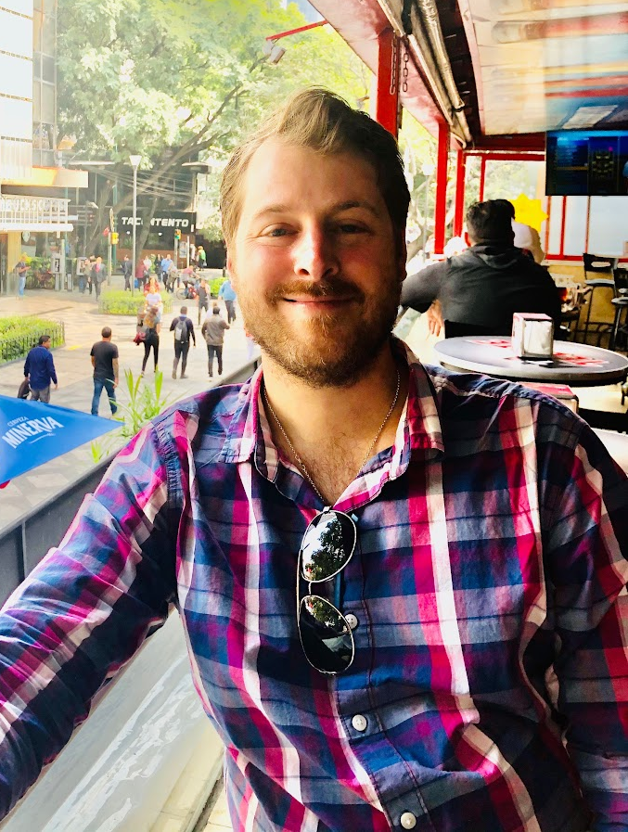
Robert Benirschke
Assistant Professor, University of Chicago, Department of Pathology (NorthShore)
Director of Core Laboratory and Point of Care testing
Director Clinical Pathology Informatics

Slide 7
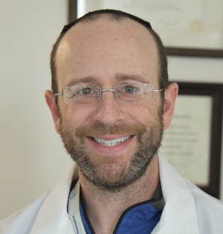
Amrom Obstfeld
Associate Professor, Department of Laboratory Medicine and Pathology, University of Pennsylvania School of Medicine
Associate Chair for Pathology Informatics, Children's Hospital of Philadelphia
Associate Medical Director, Coagulation Laboratory
Notes:
Amrom Obstfeld MD, PhD, Associate Chair for Pathology Informatics at Children’s Hospital of Philadelphia. In this role he leads the development of analytic tools to aid in quality management and operations, interfaces with other informatics groups throughout the hospital on Health IT initiatives and also designs and implements informatics educational experiences for pathology trainees and faculty at the University of Pennsylvania.

Slide 8
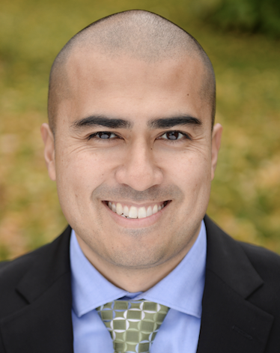
Patrick Mathias
Associate Professor, Department of Laboratory Medicine and Pathology, University of Washington School of Medicine
Vice Chair of Clinical Operations
Associate Medical Director, Laboratory Medicine and Pathology Informatics
Notes:
Patrick Mathias, MD, PhD, is the Associate Medical Director of the Informatics Division in the Department of Laboratory Medicine at the University of Washington School of Medicine. His interests include developing data science and analytics as a core competency to improve clinical lab operations and laboratory stewardship, and applying clinical informatics approaches to mitigate laboratory-associated diagnostic errors. He is interested in developing and improving programming and data science education across all levels of pathology practice.

Slide 9
Workshop Workflow

Slide 10
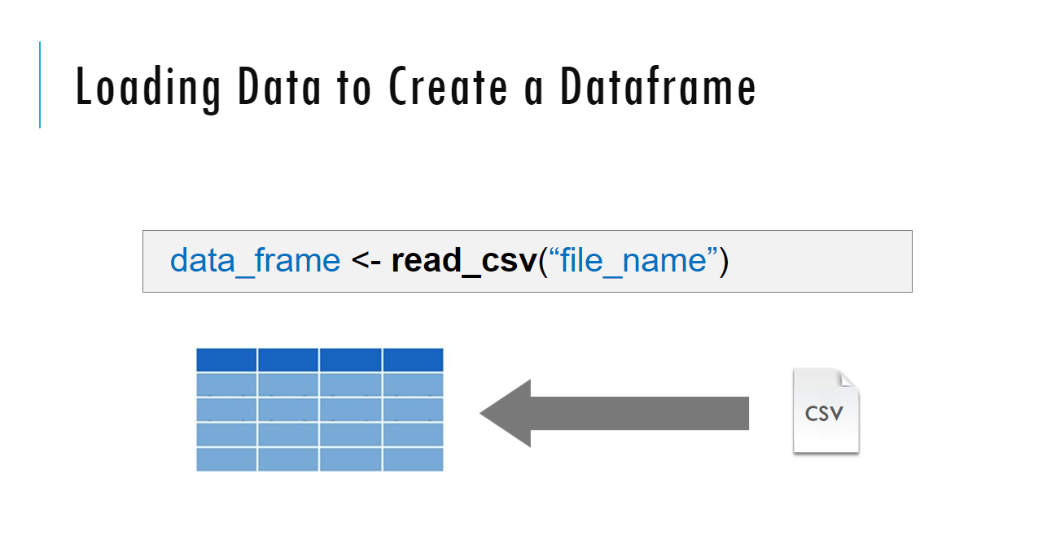
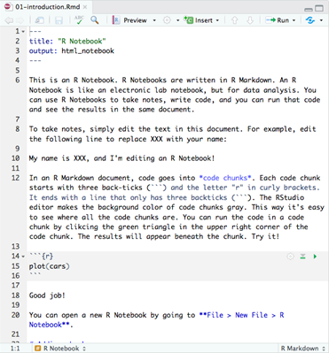
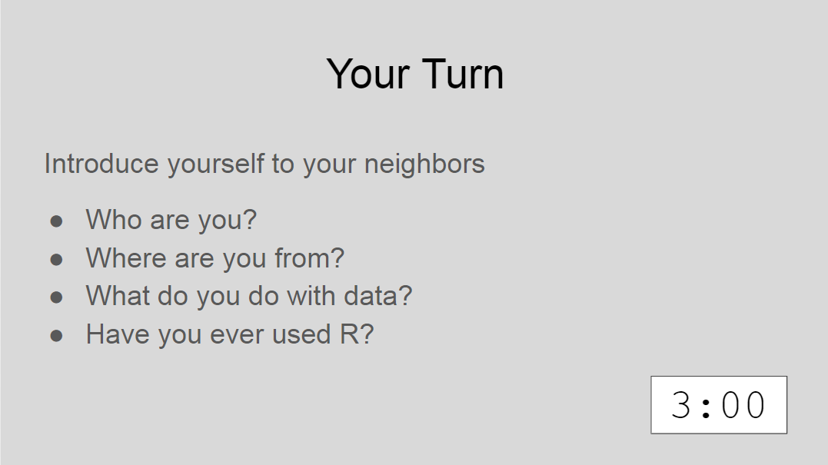
Sessions

Slide 11
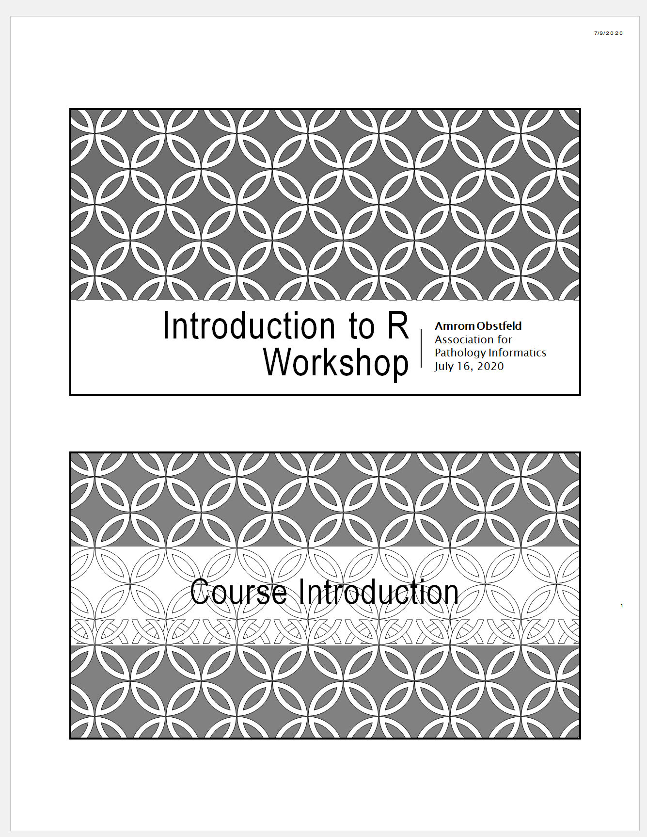
Workshop Coursebook
Coursepack folder on website contains:
PDFs for slides
Cheatsheets

Slide 12
Getting Help
Teachers will be available throughout the lectures and exercises
If you need help place a yellow sticky note on your computer or raise your hand
If you have completed the exercise place a green sticky note on your computer
Please don’t be shy!

Slide 13
Who are you?

Slide 14

Your Turn
Introduce yourself to the room
Who are you?
Where are you from?
Why are you here?
Have you ever used R?

Slide 15
Tips for learning
Cheatsheets show how to do common things – orient yourself with them early (https://posit.co/resources/cheatsheets/)
The best way to learn to code is by doing
Practice is key!
Programming is hard, even for those with a lot of experience. Find resources and ask for help!

